Slide 2


Bootcamp 2025
Carlos Valle (cgvalle@uc.cl)
Nicolás Garrido (nagarrido@uc.cl)
January, 2022

Slide 3
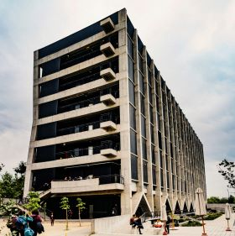
Welcome to the IIBM !!
Notes:
Carlos

Slide 4
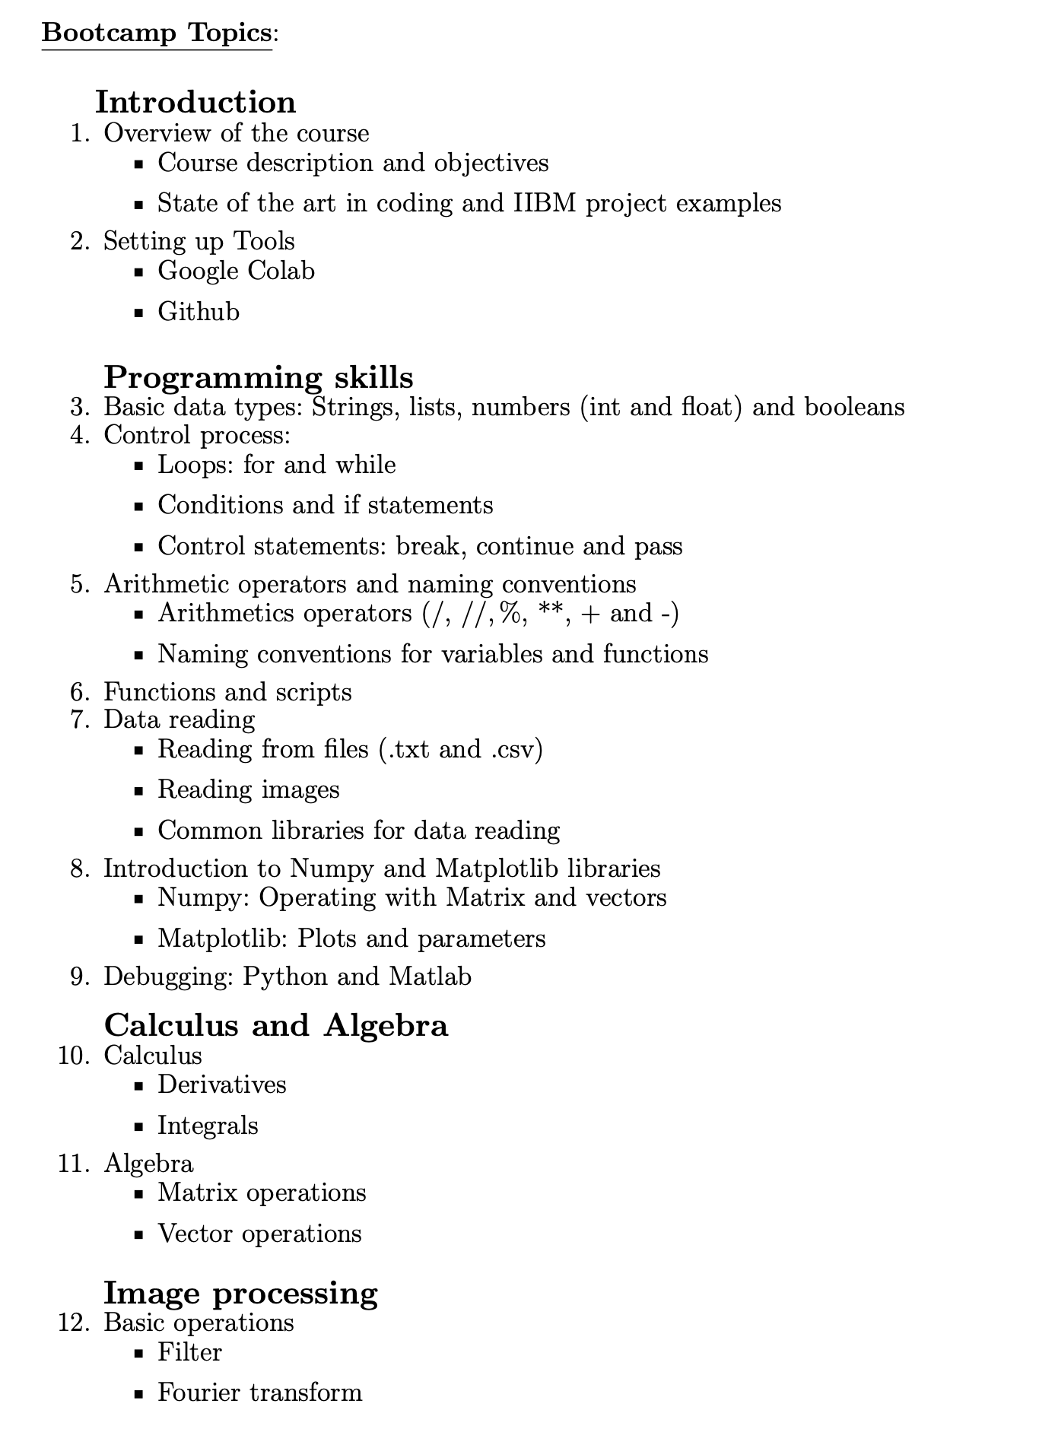


Notes:
Carlos: Esto les sera util para sus cursos de postgrado.

Slide 5
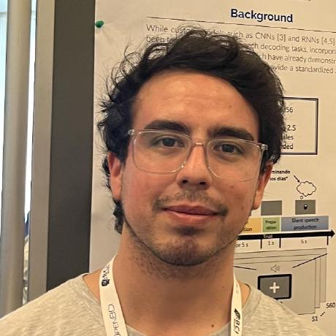
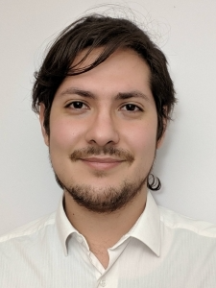
Hello !
Carlos Valle Araya, PhD.
IIBM Postgraduate student, 2019 generation
Thesis: ‘Improving Brain-to-Text Models Utilizing Recurrent Neural Networks and Transfer Learning for Neuroprosthetic Speech’
Nicolás Garrido, PhD Student.
IIBM Postgraduate student, 2023 generation
Thesis: ‘Efficient free-running multiparametric MRI, with 3D isotropic resolution at low-field (0.55 T)’
Notes:
AMbos

Slide 6
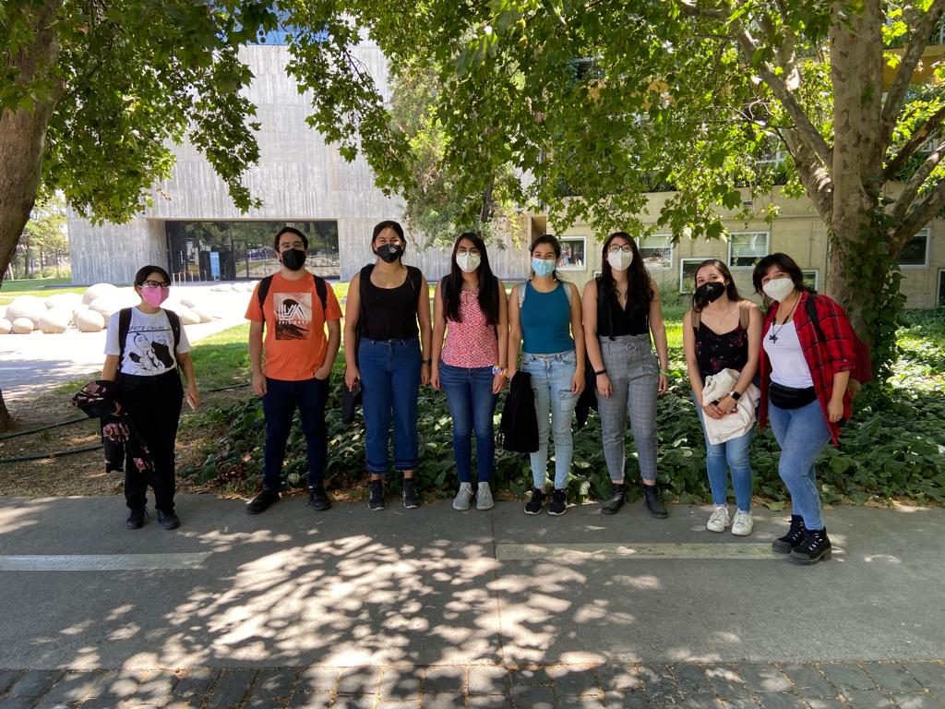
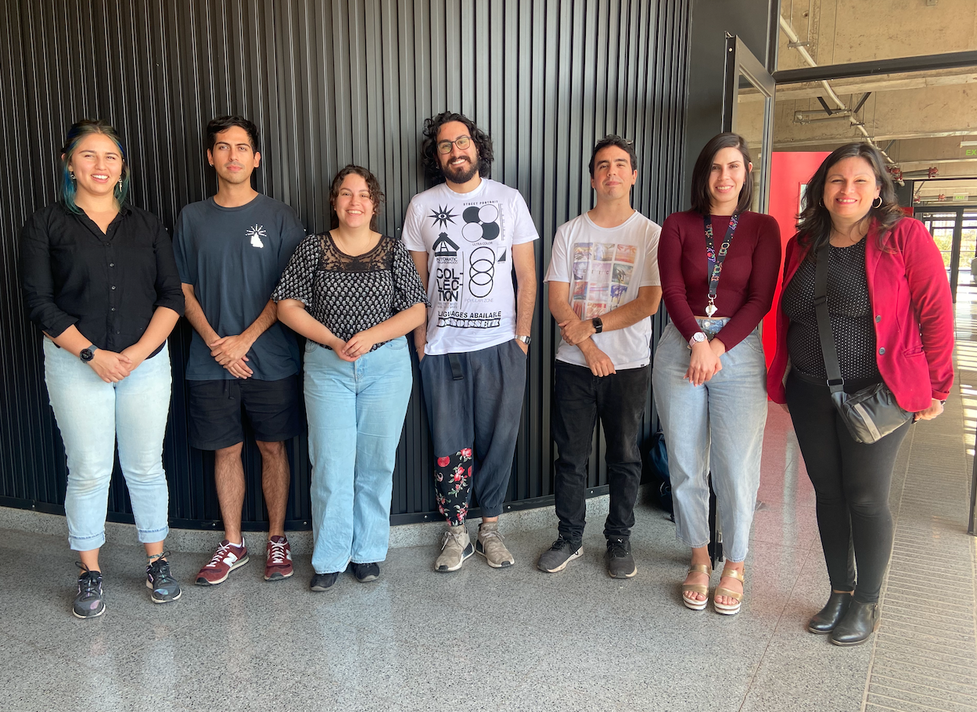
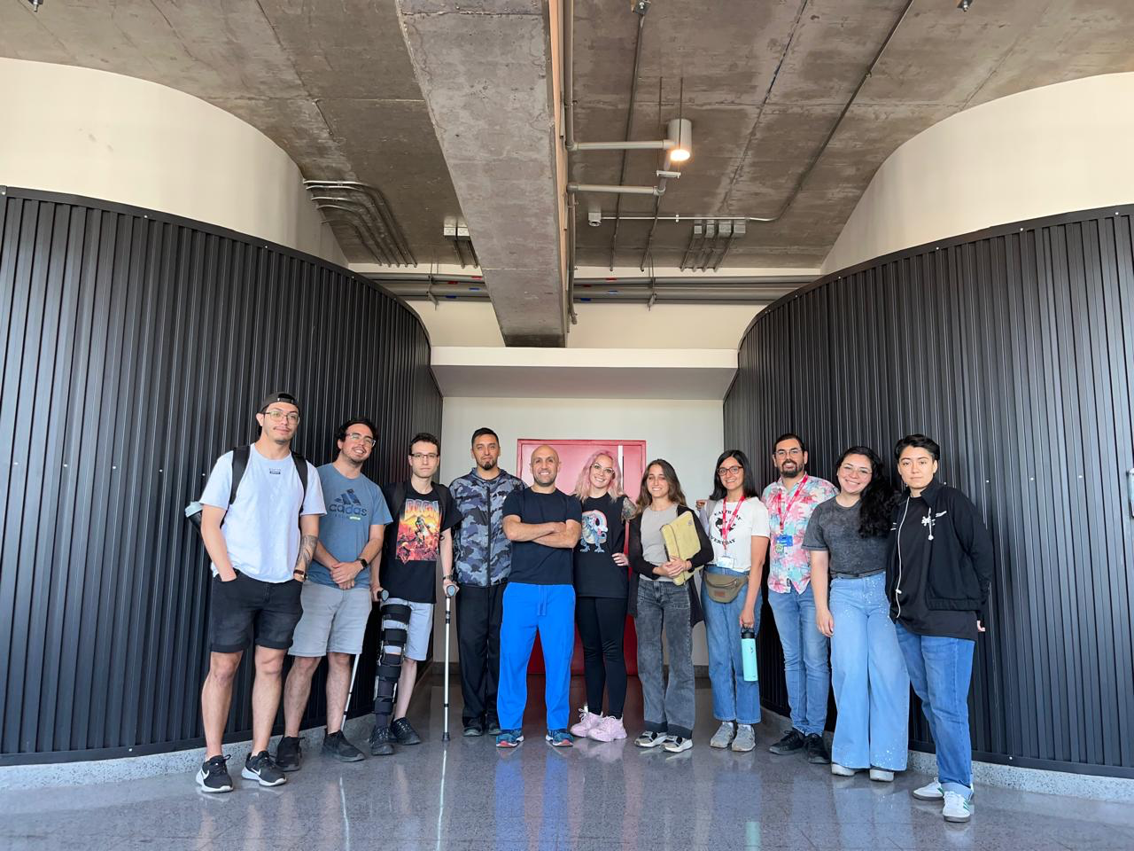
2022
2023
2024

Slide 7
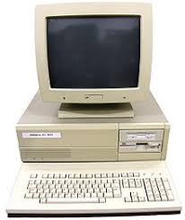

Pre requirements
Notes:
Gaby

Slide 8
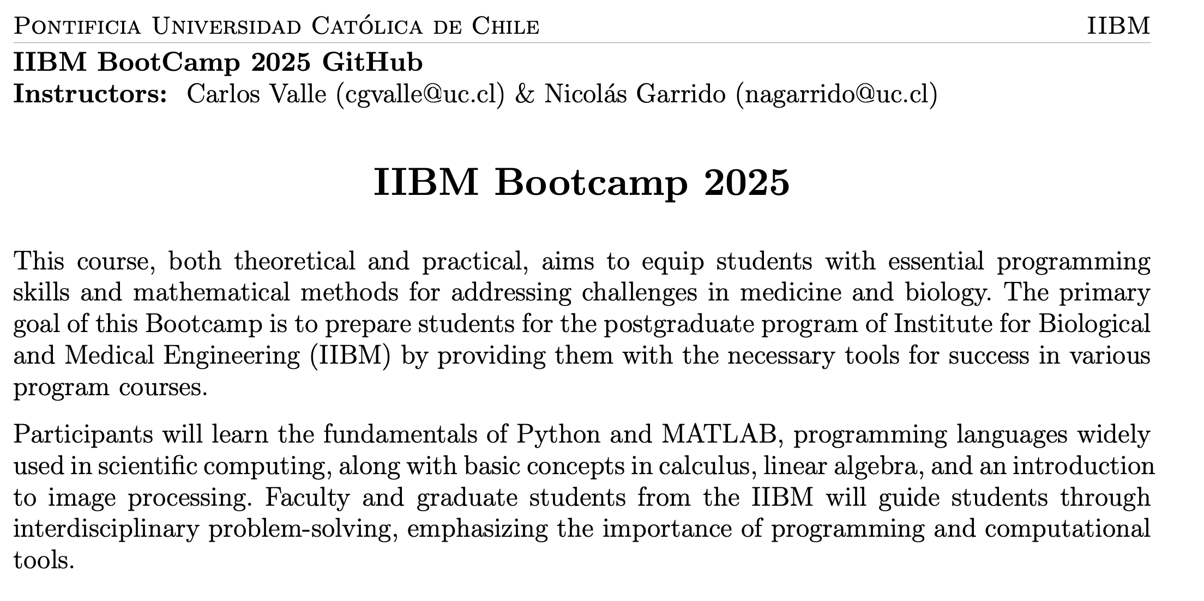
Notes:
Gaby

Slide 9
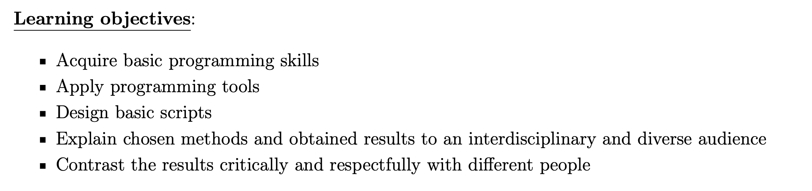
Notes:
Gaby

Slide 10
How it will work?
Notes:
Gaby

Slide 11
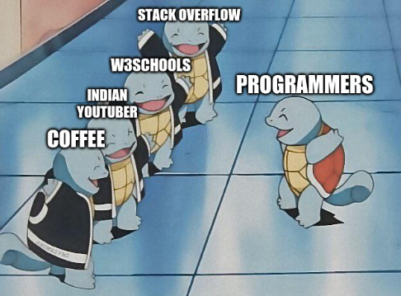
Notes:
AMBOS: Darles motivación, decir que depende de su trabajo. Y que como indian youtuber nos tienen a nosotros. Fomentar la ayuda entre ellos

Slide 12
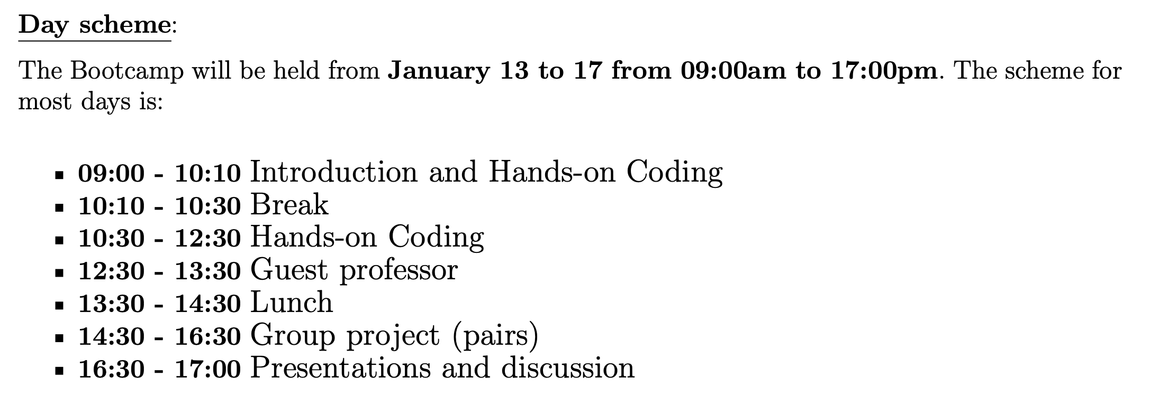
Notes:
Carlos

Slide 13
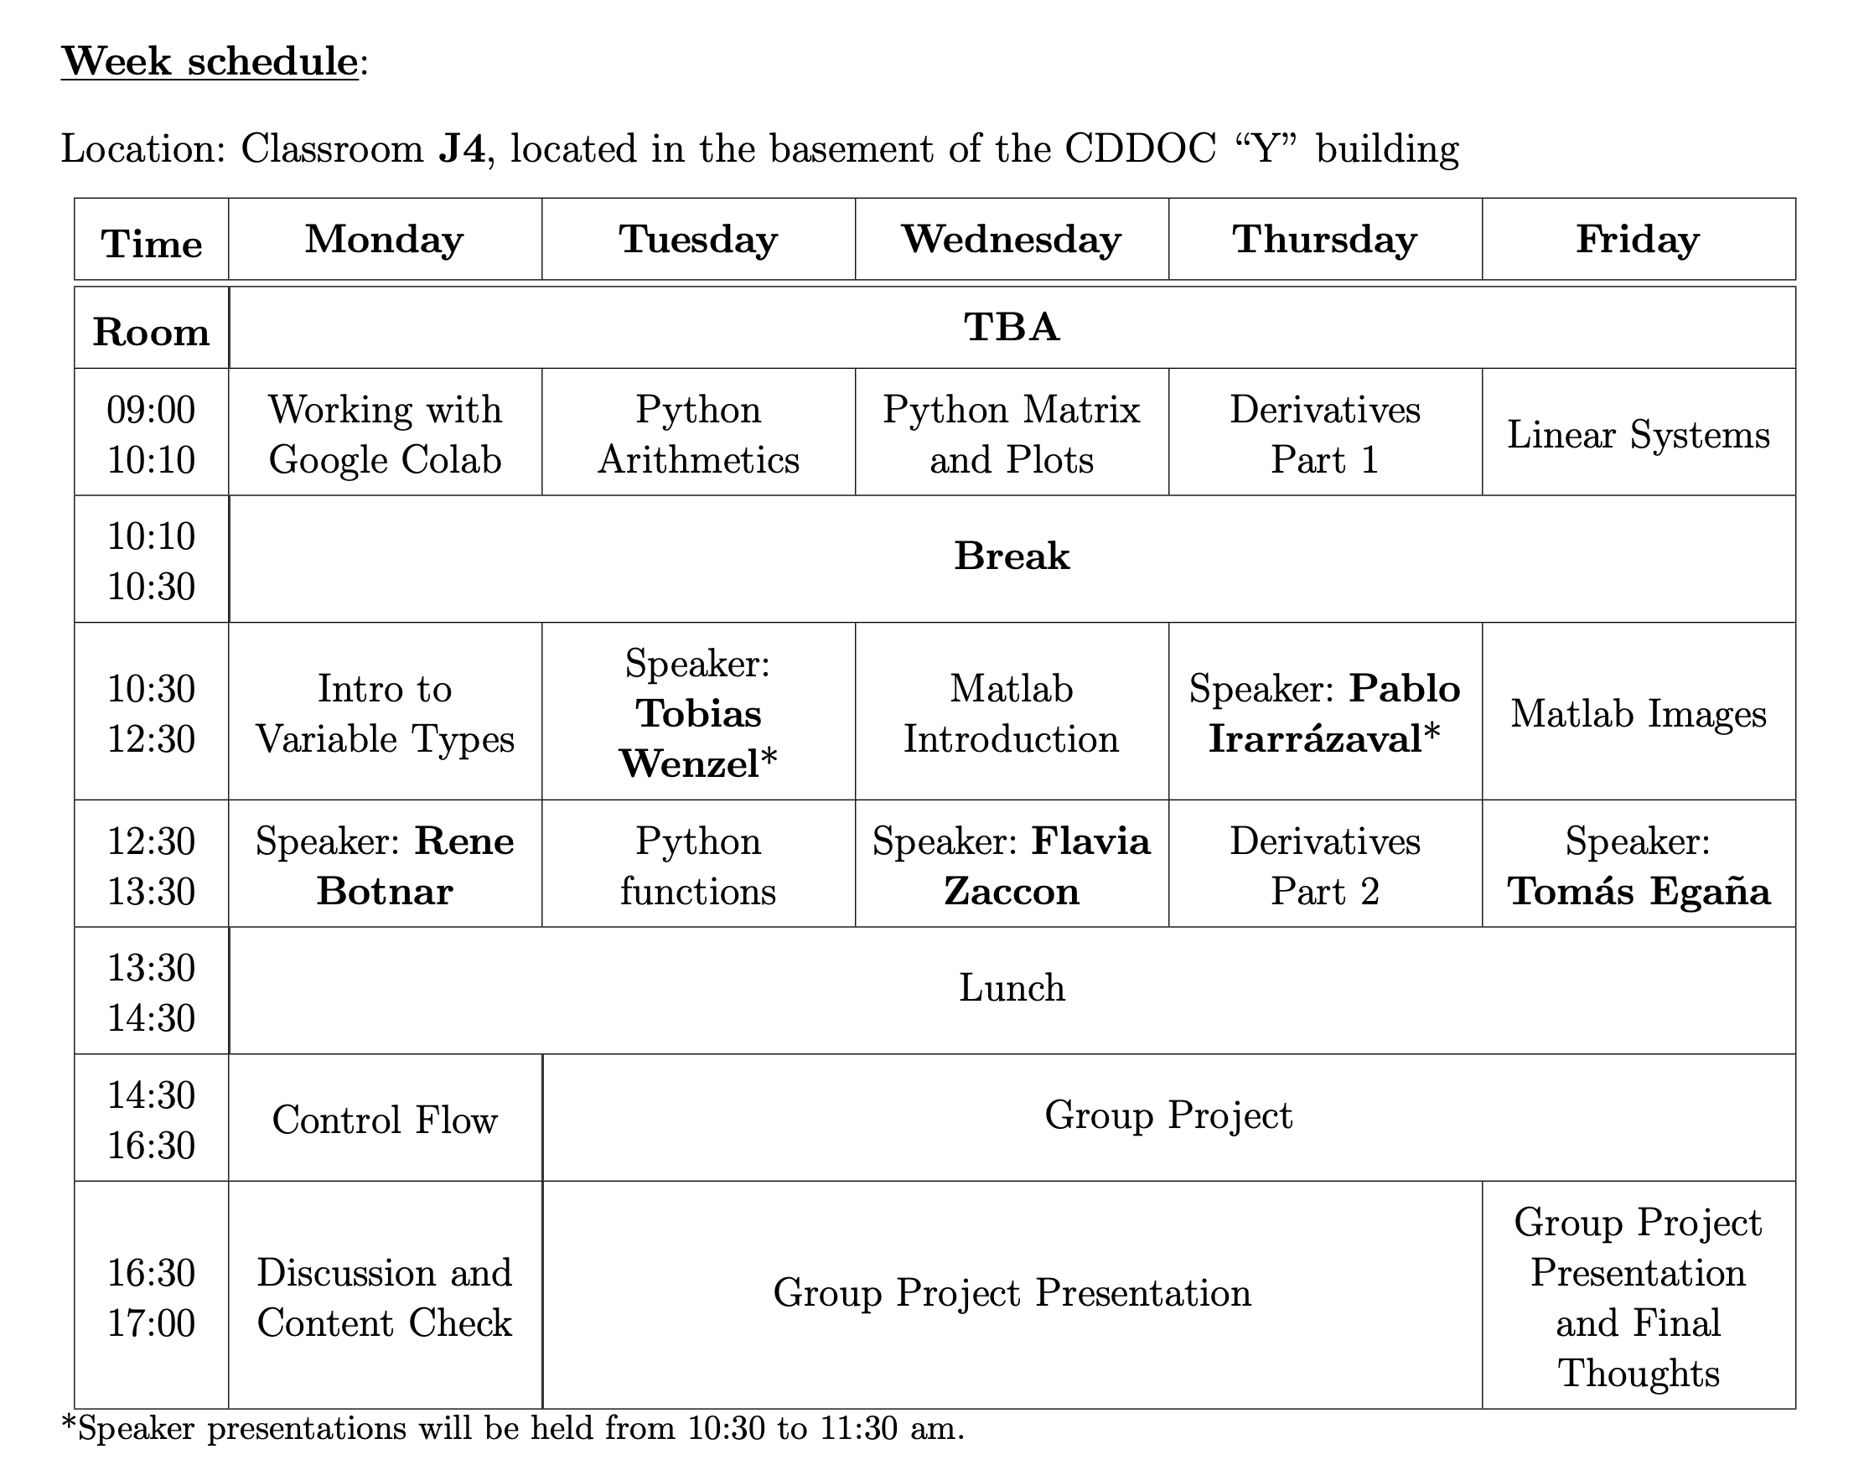
Notes:
Carlos

Slide 14
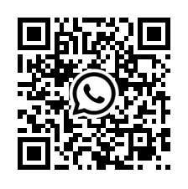
Whatsapp Group
Notes:
Carlos

Slide 15
Evaluation
No grades. But you must send your work of every day to the link that will be at the end of the documents of each session
Notes:
Carlos

